Slide 1
Improving Health Outcomes
Team : Raquel McLellan, Jessica Carns, Eliana Suarez, Solicia Xu and Steven J Bark

Slide 2

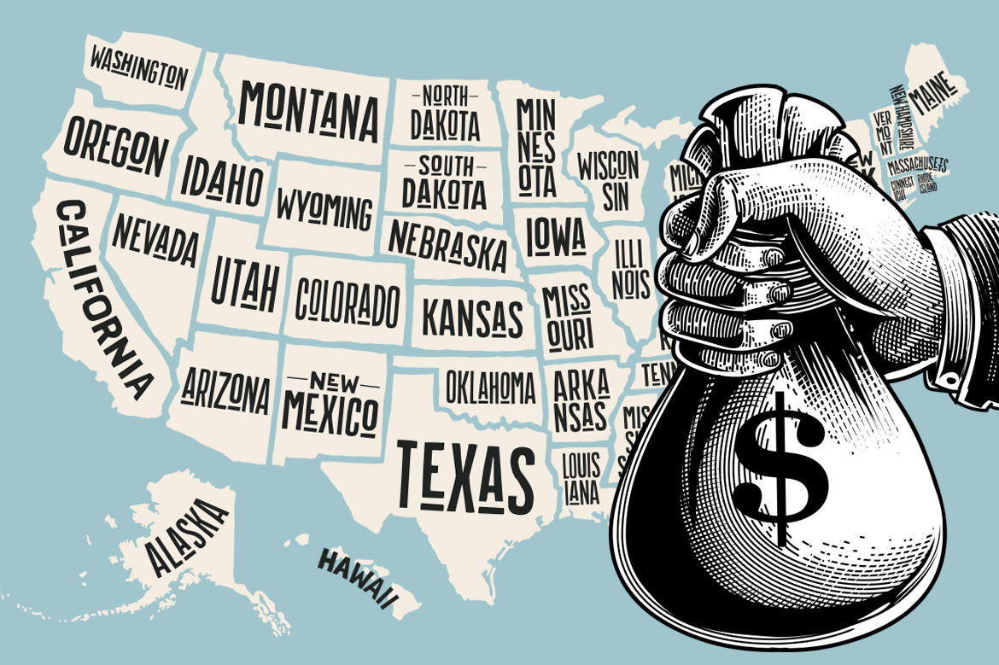


US Healthcare
$3.6 Trillion in Healthcare Spend
$3.6 Trillion in Healthcare Spend
87 Million Uninsured or Underinsured
~80% Rural Counties with a PCP shortage
122,000 Shortage of Physicians by 2030

Slide 3
Objectives
Main Objective:
Identify important factors that drive health outcomes
Use Random Forest Regression model to target critical health factors
Determine the best community health center type and setting based on county health factors
Use KNN model to cluster health center type and location to top health factors

Slide 4

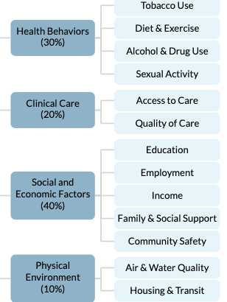
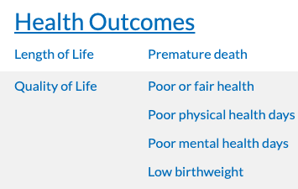

Data Sources

Slide 5







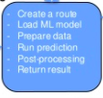



Data Cleaning
Store Data
Supervised ML
Train and Predict
Save Models
Model Deployment
Define Top Health Factors Using Random Forest
Health Centers cluster with KNN
Machine Learning Deployment Diagram
Request and Response
Visualizations

Slide 6
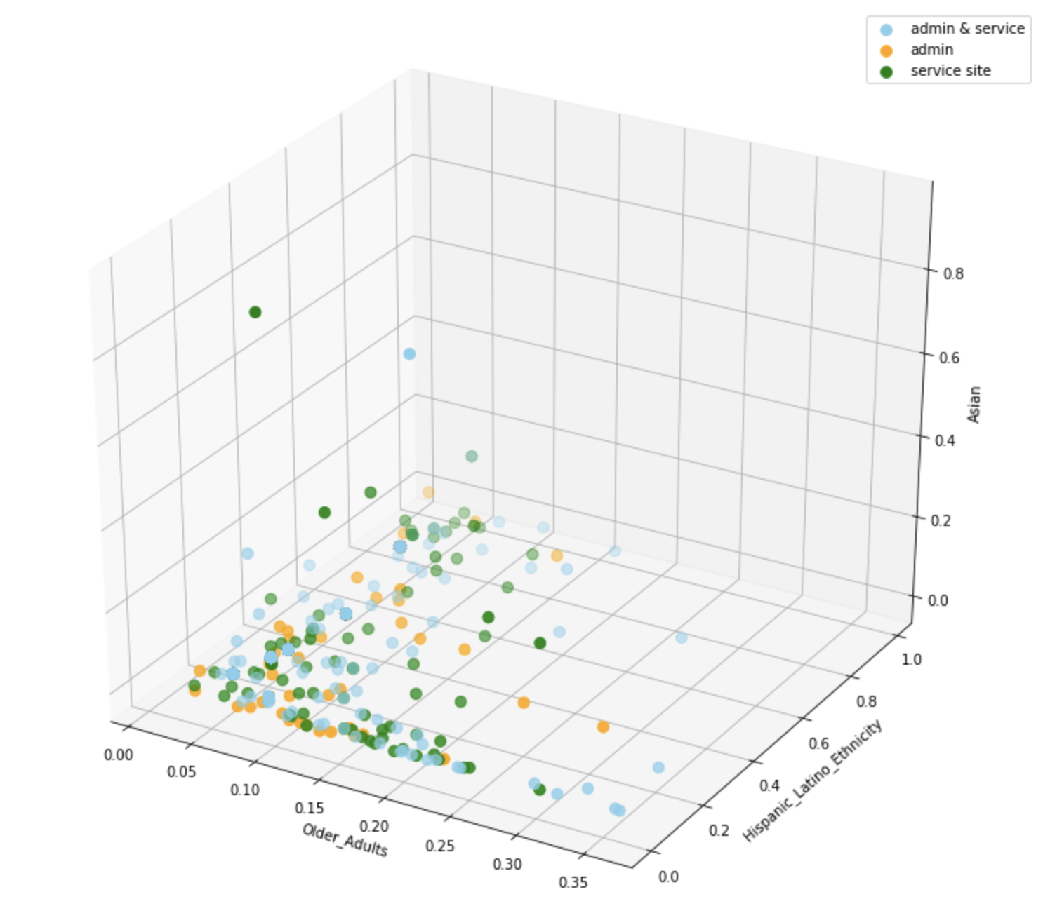
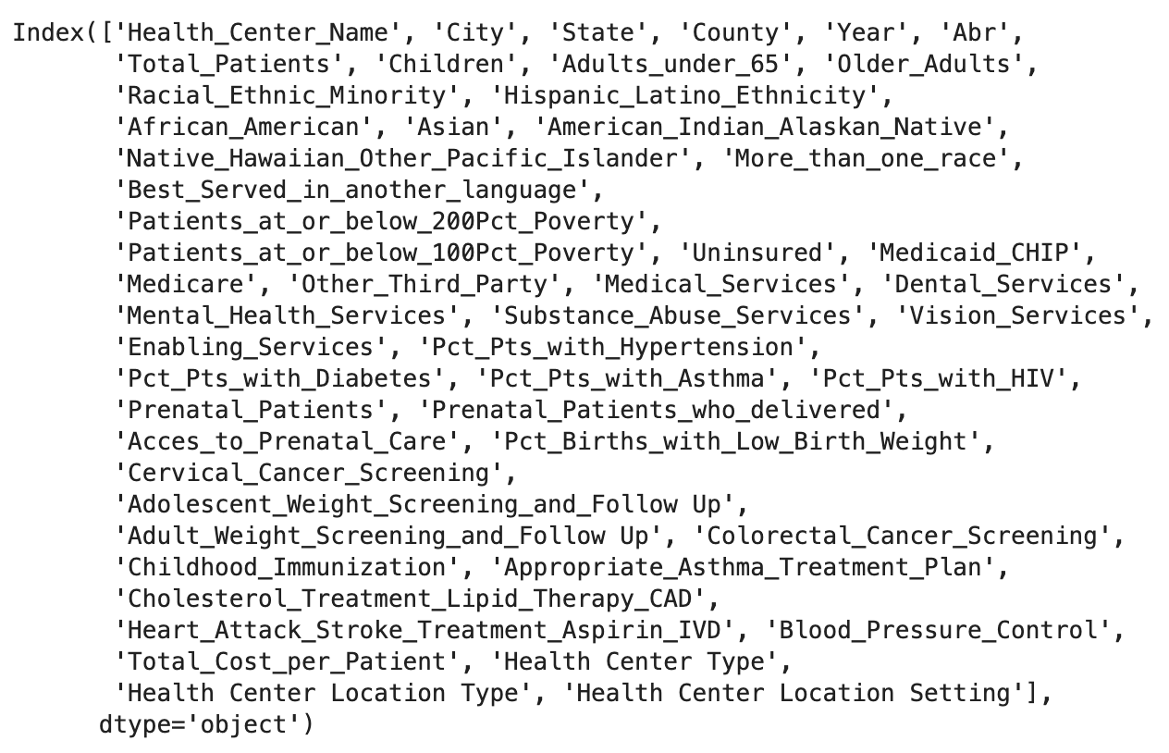
KNN Model to classify different health center types

Slide 7
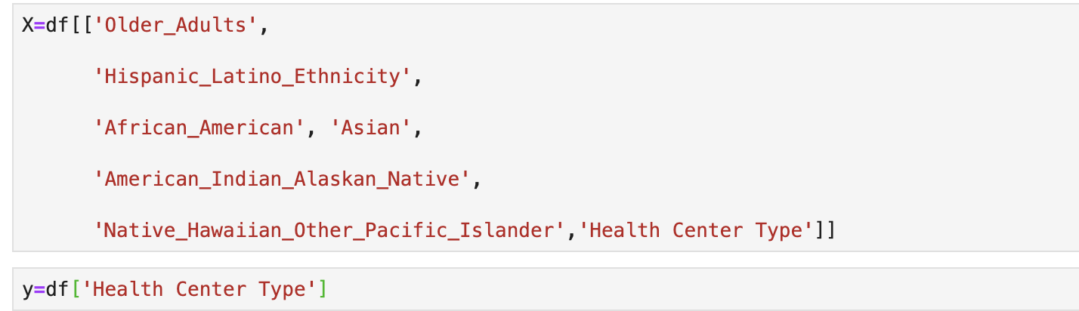
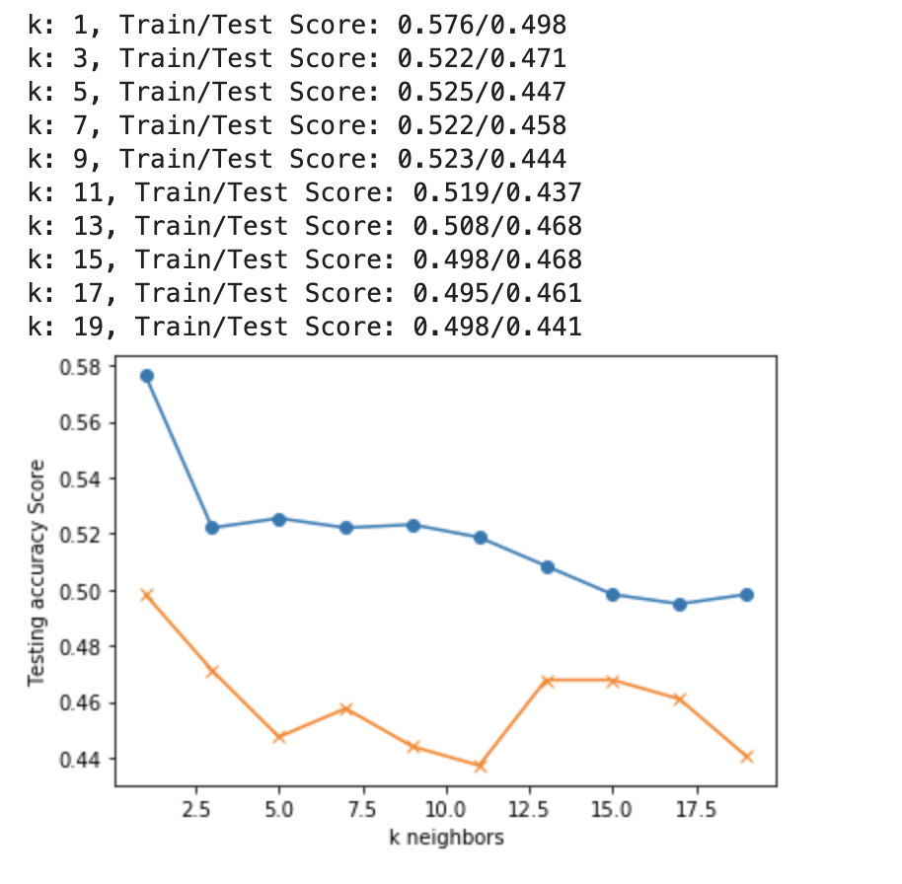
KNN Model

Slide 8
KNN Model Result (138 out of 295 match, 46.8% accuracy)

Slide 9
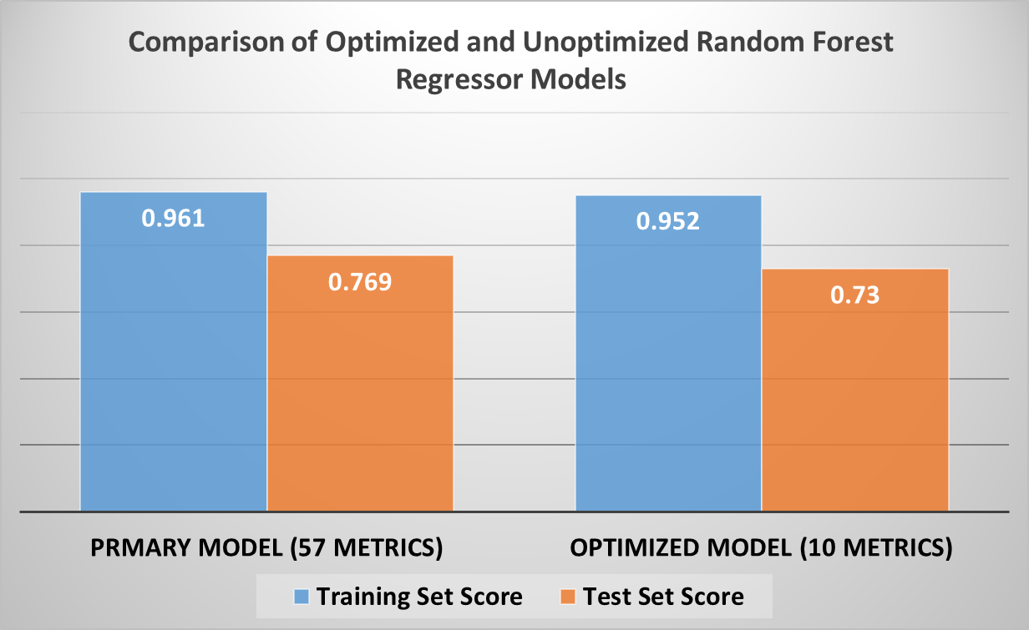
Initial Random Forest Regression Optimization of Metrics

Slide 10
Conclusions
Main Objective:
Important socioeconomic factors
Random Forest Regression model identified target metrics.
Important health center type correlations to top metrics
KNN clustering identified correlations to health centers

Slide 11
Big Data
County Health Rankings
19,150 records across county level metrics for each state plus the District of Columbia from 2015 - 2020
54 metrics common to all years
3,148 distinct FIPS county codes in dataset
Caveats include:
Not all counties were in all years due to redistricting or consolidation
Certain metrics had to be converted to equate to other years due to changes in how the data reporting evolved
Health Resources & Services Administration
8,180 records of Community Health Center providers from 2016 - 2018
42 metrics on outcomes and patient characteristics
14,013 current Community Health Center Providers
Caveats include:
Data bias toward All Other Clinics Type in location setting
Deidentification of Domestic Violence centers will impact prediction for this setting
Due to shifts in providers between years, not all with metrics still operate nor were current providers all incorporated in measurements

Slide 12
Hierarchal Clustering of Health Care Metrics Unique Metrics 57

